Slide 1


Data Analysis of Bike Rentals Across Time and Conditions
Understanding rental patterns to optimize bike-sharing services.
Ammar Al-Ghouli
Contact: ammaralghouli100@gmail.com
Date:12-2024

Slide 2
Problem Statement
Challenges:
Fluctuations in demand during the day and across conditions.
Need for better resource allocation (bike availability, maintenance).
Reduced rentals during unfavorable conditions (holidays, weather).
Business Questions:
What times and conditions have the highest demand?
How can we optimize fleet management to maximize usage and customer satisfaction?

Slide 3
Overview of the Data Analyzed
Dataset:
Source Bike Sharing Demand Kaggel
Contains bike rental counts categorized by:
Time dimensions: Hour, day, month, season.
Conditions: Working day, holiday, weather.
Metrics analyzed: Rental counts under different conditions.
Visual Aid:
Include a clean table or a small bar chart showing a sample of the data (e.g., rental counts per hour or season).

Slide 4
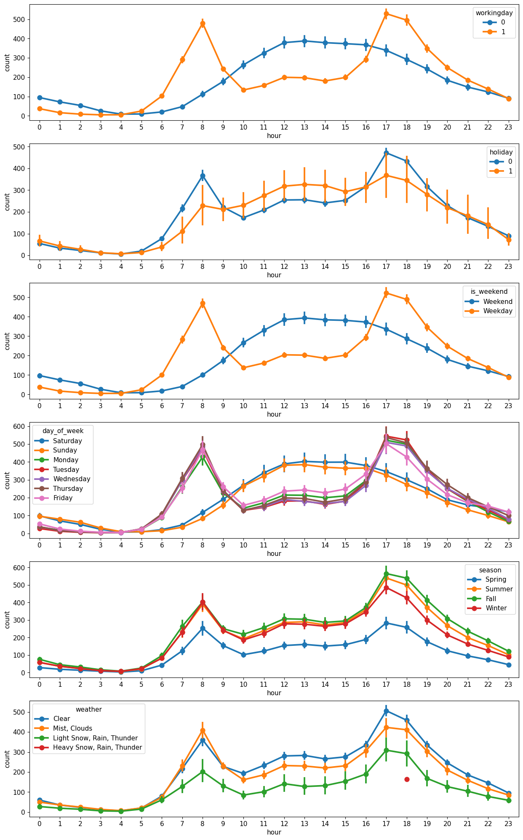

Slide 6
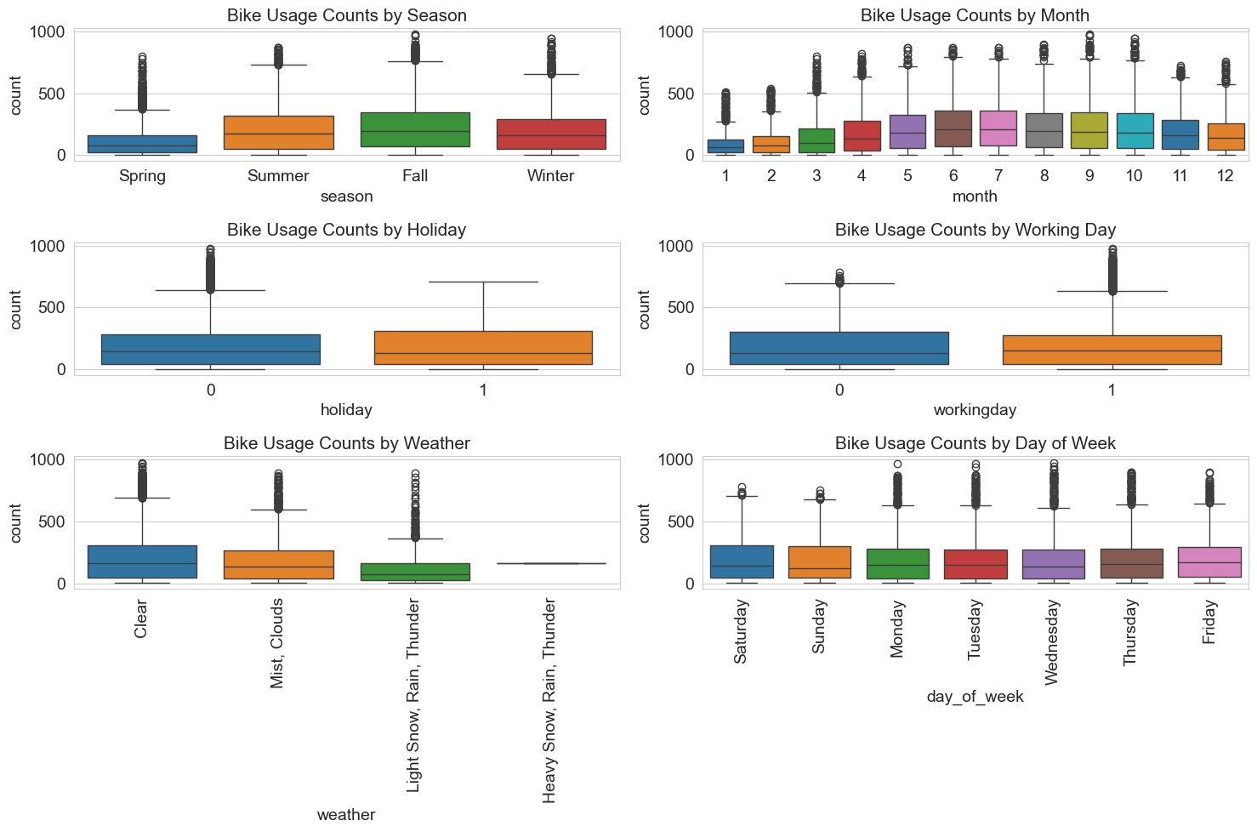

Slide 7
Key Insights and Findings

Slide 8
Key Insights and Findings
From this we can see the following insights:
Bike demand is more in morning and evening hours on working days \ non-holidays \ weekdays
Bike demand is more in the afternoon hours on holidays \ weekends
Bike demand is the most on clear weather days and least on snowy days
Bike demand is most in Summer and least in Spring season
Median Bike demand is more in the summer and fall
Median Bike demand is more on clear weather days

Slide 9
Recommendations and Next Steps

Slide 10
Recommendations:
Allocate more bikes during commuting hours and mid-day weekends.
Adjust maintenance schedules to match low-usage times (e.g., rainy or winter days).
Enhance marketing during low-demand periods (e.g., Winter promotions).
Next Steps:
Use predictive analytics to forecast demand under specific conditions.
Implement dynamic bike redistribution based on demand patterns
Collect Data for last 10 Years to get more point of view about the actual Pattern especially with the development of E-scooters

Slide 11

Thanks a lot!
Contact
Ammar Al-Ghouli Information System Engineer
ammaralghouli100@gmail.com

